Slide 1
Object Oriented Programming in Java Lecture 4
Java GUI and Internet

Slide 2
Outline
Swing – Java Graphical User Interface
Networked Computers
Internet Addresses
Application Programs and Ports
Internet Domains
Accessing Internet Resources in Java
Processing Internet Addresses
Uniform Resource Locators (URL)

Slide 3
Swing – Java GUI
Swing is the primary GUI widget toolkit in Java.
It is developed to provide a more sophisticated set of GUI than earlier AWT (Abstract Window Toolkit).
Swing is part of JFC (Java Foundation Class) which includes a group of features for building GUI.
Swing can provide buttons, checkboxes, labels, and more advanced controls such as tabbed panel, scroll pane, trees, tables and lists.
Swing is lightweight: its components are not implemented by platform-specific code. Instead they are written entirely in Java and therefore are platform-independent.
import javax.swing.Jframe;
public class url2inet extends javax.swing.Jframe;

Slide 4
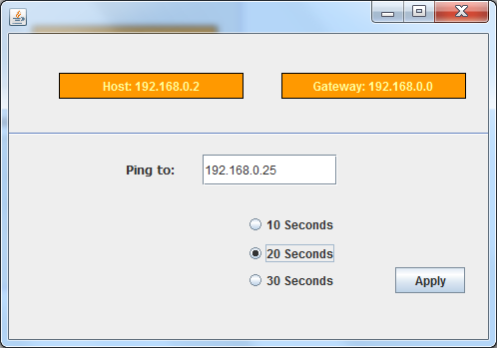
Swing – Java GUI
jFrame
Separator
Label
Label
TextField
RadioButton
Button

Slide 5
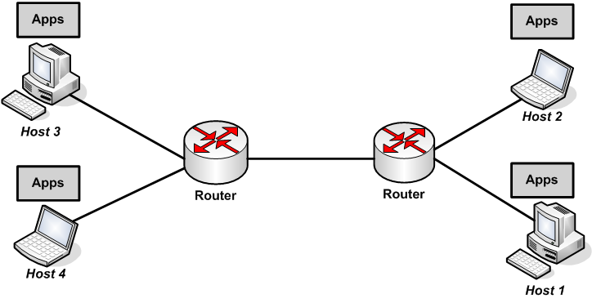
Networked Computers
Computer Network = Computers + Network Devices (e.g. Internet Backbone devices, optical fibres, routers, …)
Computers connected to the Internet are called hosts. They host user applications such as client applications (e.g. the browser, email client application, etc.)/server application (e.g. email servers, databases, web servers, etc.)
Programs/applications on hosts can communicate with each other according to a particular protocol → html (web)
ftp (file transfer protocol)
pop3/smtp (email)
ssh (secure shell)

Slide 6
Networked Computers
Every networked machine has a unique identifying number known as IP Address. Internet is the largest IP-based network.
Internet addresses are assigned by the Internet Network Information Centre (InterNIC).
Classic Internet addresses are 32-bit numbers that uniquely identify each host. 0.0.0.0 – 255.255.255.255
aaaaaaaa.bbbbbbbb.cccccccc.dddddddd ~ A.B.C.D
Organisations are assigned a block of addresses by the InterNIC:
IP Classes
Byte 3
Byte 2
Byte 1
Byte 0
A
B
C
NETWORK
HOST
2^24 addresses
65536 addresses
256 addresses
NETWORK
HOST
NETWORK
HOST

Slide 7
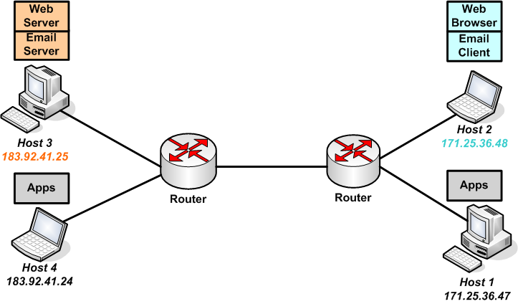
Networked Computers
Modern computers do different things at once, but have one network connection. How can multiple applications be serviced?
Every networked application is bound to a specific port that serves as a private communication channel with the network.
#80
#22
#24
#11
171.25.36.48: 24 ← → 183.92.41.25: 80
171.25.36.48: 11 ← → 183.92.41.25: 22

Slide 8
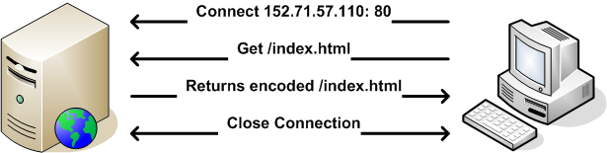
Networked Computers
HTTP defines web client - server communication
HTML (Hyper Text Mark-up Language) http://www.doc.ntu.ac.uk/index.html
ftp
echo
http
telnet
Network Application
80 21 23 7
Comm.
port
TCP/IP or UDP
Transfer Protocol
Data Packet
Port #80 Data

Slide 9
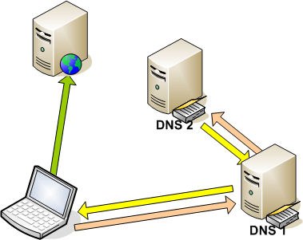
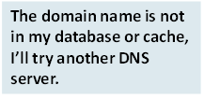

Swing – Java GUI
Domain Name Server (DNS)
Domain Name
Service (DNS)
152.71.58.2
pca2.doc.ntu.ac.uk
That’s in my cache! It maps to
URL | IP Address http:/www.ntu.ac.uk 152.71.58.2
http:/www.cnn.com ..................
3
5
4
Thanks for the IP address
152.71.58.2
Great! I’ll cache that in case I get more requests.
1
2

Slide 10
Swing – Java GUI
www.ntu.ac.uk
World Wide Web
UK Academic Domain
uk
com
edu
ac
co
ntu
Other Universities in UK
Nottingham Trent University Domain

Slide 11
Accessing Internet Resources
Processing Internet Addresses
The java.net.InetAddress class represents an Internet Address
Creating New InetAddress Objects
InetAddress addr getByName(String hostname)
InetAddress[] getAllByName(String hostname)
InetAddress getLocalHost()
hostName
(String)
pca2.doc.ntu.ac.uk
address
(int)
152.71.58.2

Slide 12
Accessing Internet Resources
//printing the Internet addresses of the web server and the local host
import java.net.*;
class doc {
public static void main (String args[])
{
try {
InetAddress address1 = InetAddress.getByName("www.doc.ntu.ac.uk");
InetAddress address2 = InetAddress.getLocalHost();
System.out.println(“Web Server: “ + address1);
System.out.println(“My PC: “ + address2 );
}
catch (UnknownHostException e) {
System.out.println("Could not find Departmental Web Server");
}
}
D:\> java doc
Web Server: www.doc.ntu.ac.uk/152.71.57.110
My PC: pca2/152.71.58.2

Slide 13
Accessing Internet Resources
URL - locating a resource on the Internet
In Java, java.net.URL - is the class representing URL objects, and has the following main fields:
String protocol - the protocol used to access the server
String host - name of the server
int port - connection to the protocol server
String file - location of a file on server
protocol://hostname[:port]/path/filename#section
file
Ftp
http
DNS name
IP address
“80” by
default
index.html
by default
http://java.sun.com/products/jdk/1.2/docs/index.html

Slide 14
Accessing Internet Resources
Constructors are used to create new URL objects.
Constructors throw MalformedURLException if the URL protocol is not supported.
The simplest constructor creates a URL object from a String that represents the URL address:
Public URL(String url) throws MalformedURLExeption
The department of computing URL can be created as follows:
URL compDept = new URL(“http://www.doc.ntu.ac.uk/”);
Building relative URLs
URL compDept = new URL(“http://www.doc.ntu.ac.uk/”);
URL compResearch = new URL(compDept, “reseach.html”);
URL compStaff = new URL(compDept, “people.html”);

Slide 15
Accessing Internet Resources
Parsing URL
Information about the URL fields can be obtained with the URL class query methods.
getProtocol(), getHost, getPort(), getFile(), getRef()
To acquire the protocol used for browsing the DoC page:
URL compDept = new URL(“http://www.doc.ntu.ac.uk/index.html”);
String docProtocol = compDept.getProtocol();
Retrieving Data from a URL
The java.net.URL class has three methods to retrieve data for a URL:
public final InputSteam openstream() throws IOException
public URLConnection openConnection() throws IOException
public final Object getContent() throws IOException

Slide 16
Accessing Internet Resources
// reading directly from a URL
import java.net.*;
import java.io.*;
class OpenStreamTest {
public static void main(String[] args) {
try {
URL compDept = new URL("http://www.doc.ntu.ac.uk/");
DataInputStream ins =
new DataInputStream(compDept.openStream());
String inString;
while ((inString = ins.readLine()) != null) {
System.out.println(inString);
}
ins.close();
} catch (MalformedURLException me) {
System.out.println("MalformedURLException: " + me);
} catch (IOException ioe) {
System.out.println("IOException: " + ioe);
}
}
}

Slide 17
Accessing Internet Resources
OpenStreamTest output
<HTML>
<HEAD>
<META HTTP-EQUIV="Content-Type" CONTENT="text/html; charset=iso-8859-1">
<META NAME="GENERATOR" CONTENT="Mozilla/4.0 [en] (WinNT; I) [Netscape]">
<TITLE>The Department Of Computing</TITLE>
<FRAMESET COLS="20%,80%" BORDER="0" frameborder="NO">
<FRAME SRC="newlook/navig.html" NAME="Navigational Frame" SCROLLING=NO>
<FRAME SRC="newlook/home.html" NAME="Main Frame">
<NOFRAMES>
</HEAD>
<BODY>
<CENTER><IMG SRC="studprof.jpg" HEIGHT=287 WIDTH=393></CENTER>
</BODY>
</NOFRAMES>
</FRAMESET>
</HTML>

